Slide 1

ECE 281 Lesson 29
1

Slide 2
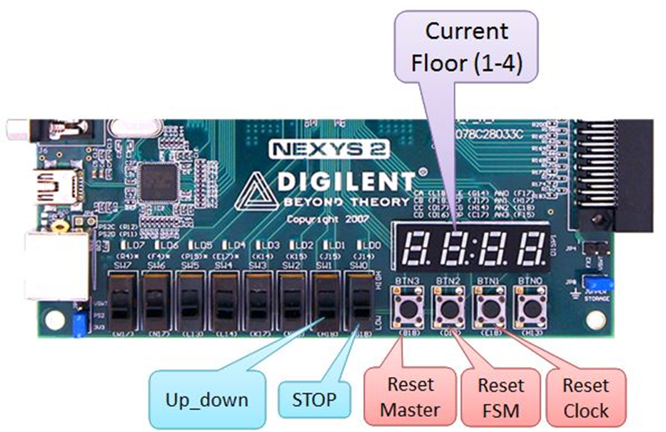
Lab3 – Due Friday
How is it going?

Slide 3
Lesson 29 Outline
Do Time Logs!
Review
Assembly
Assembly to Machine Code

Slide 4
Architecture vs Micro-Architecture
Architecture: the programmer’s view of the computer
Defined by instruction set and operand locations (i.e. registers, instructions, and memory)
Types – x86, PowerPC, ARM, and MIPS
Micro-architecture: how to implement an architecture in hardware – Pentium, A10
Specific arrangement of registers, memories, ALUs etc.
Many different microarchitectures exist for a single architecture

Slide 5
Computer Block Diagram
CPU
Memory
Input/
Output
Outside
World
Control
Datapath
ALU
Control Bus
Data Bus
Address Bus

Slide 6
Components of Computer Architecture
1) CPU – Central Processing Unit
Controller – makes other components work together
Datapath – does computations; keep track of where we are. What are we tracking?
Program Counter
2) Memory – Stores information (code and data)
Address – where info is located
Data – what info is
3) I/O – data goes in/out to/from the outside world

Slide 7
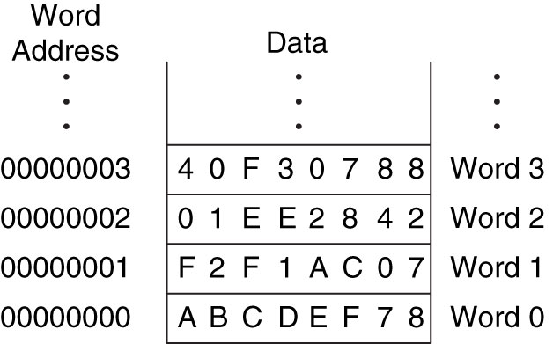
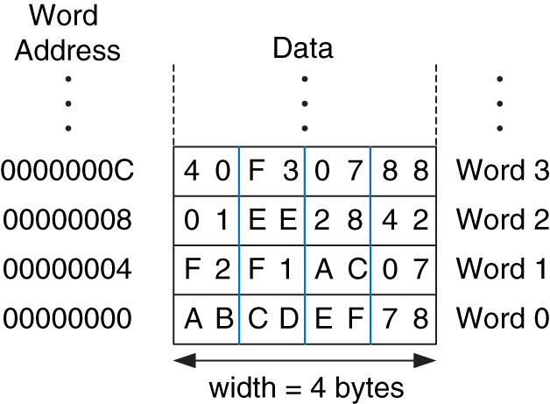
Addressable Memory
width =
width = 1 word (32-Bits)
Figure 6.1 Word-addressable memory
Copyright © 2013 Elsevier Inc. All rights reserved.

Slide 8
CISC vs RISC
RISC
Reduced Instruction Set Computer
CISC
Complex Instruction Set Computer
Tradeoffs RISC vs CISC
more instructions == more complex hardware
Complex
SW
Complex
HW

Slide 9
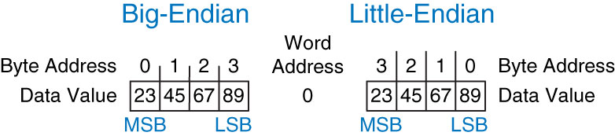
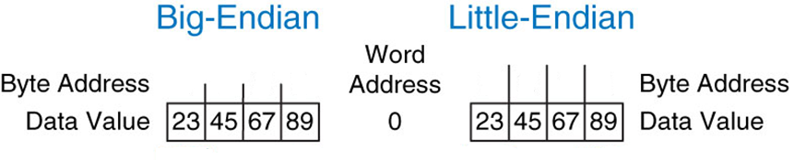
Big-Endian vs Little-Endian
Big-Endian – Byte numbering starts @ MSB
Little-Endian – Byte numbering starts @ LSB
Figure 6.4 Big-endian and little-endian data storage
Copyright © 2013 Elsevier Inc. All rights reserved.

Slide 10
MIPS Architecture
The MIPS Architecture consists of:
A set of operations (instructions)
I-Type, R-Type, J-Type
Data units (sizes, addressing modes, etc.)
32-Bit Data Word
Registers
32, 32-bit registers
Interaction with memory
Harvard Architecture
Load and Store
Program counter
32-bit PC
Is MIPS byte-addressable or word-addressable memory?
Is MIPS Little-Endian or Big-Endian?
Is MIPS RISC or CISC?

Slide 11
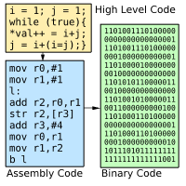
Compiler/Assembler Translation
Translating a Program to Machine Code
Higher Level Language (HLL)
Compiler
Assembly Language
Assembler
Machine Code

Slide 12
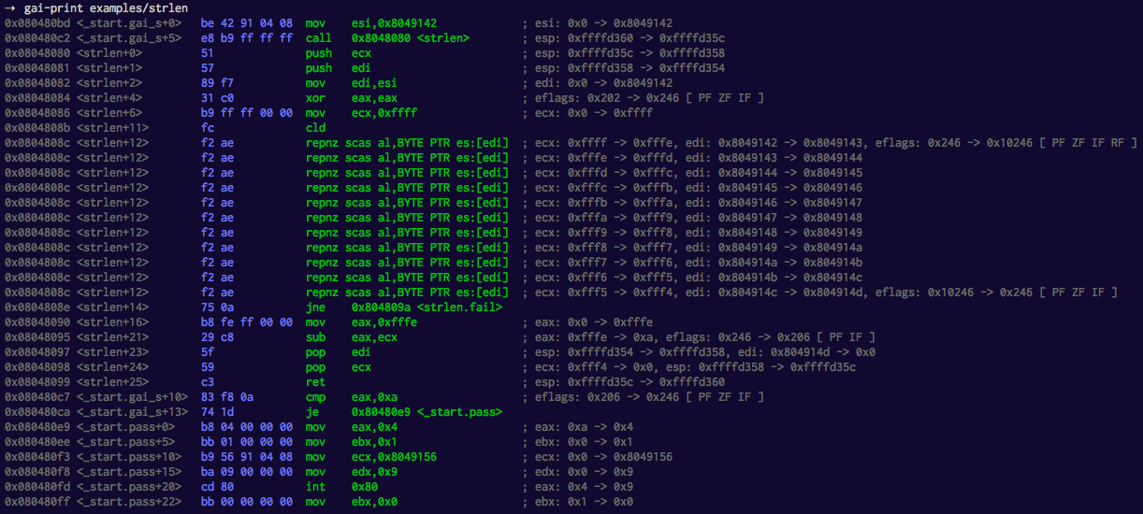
Assembly Code

Slide 13
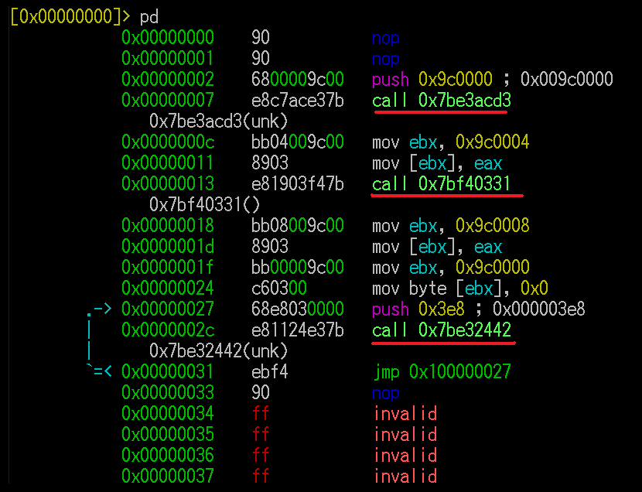
Assembly Code

Slide 14
Assembly Code
Mnemonic – name of an operation/instruction
Opcode – binary representation of mnemonic
Operand – target of operation/instruction
lw $s3, 4($0)
➔ 100011 (found in Appendix B of book)
MIPS Architecture:
$ indicates a register
32 Registers
32 bits in a word
$0 $t $s
Mnemonic
Operands
Opcode

Slide 15
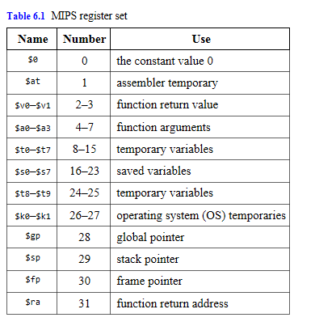
MIPS Register Set
We will focus in 281 on these, but 382 will do more
Copyright © 2013 Elsevier Inc. All rights reserved.

Slide 16
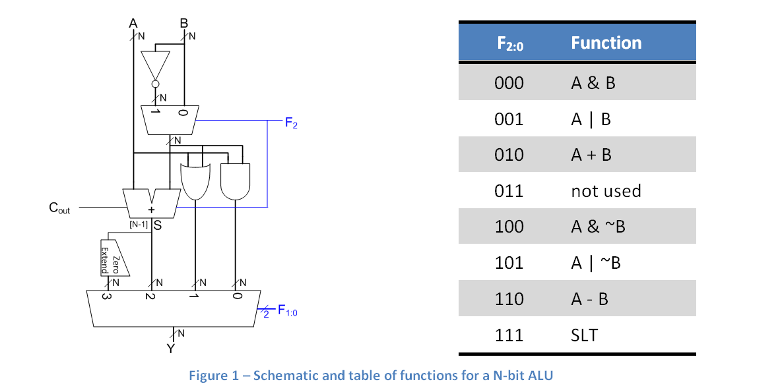
Lab 4
These will be registers in our MIPS processor
Mnemonic

Slide 17
MIPS Instruction Types
R-Type Instructions – Register Type
I-Type Instructions – Immediate Type
J-Type Instructions – Jump Type
R-Type
op | rs | rt | rd | shamt | funct
6 bits | 5 bits | 5 bits | 5 bits | 5 bits | 6 bits
R-Type
op
6 bits
I-Type
op | rs | rt | imm
6 bits | 5 bits | 5 bits | 16 bits
I-Type
op
6 bits
J-Type
op | addr
6 bits | 26 bits
J-Type
op
6 bits

Slide 18
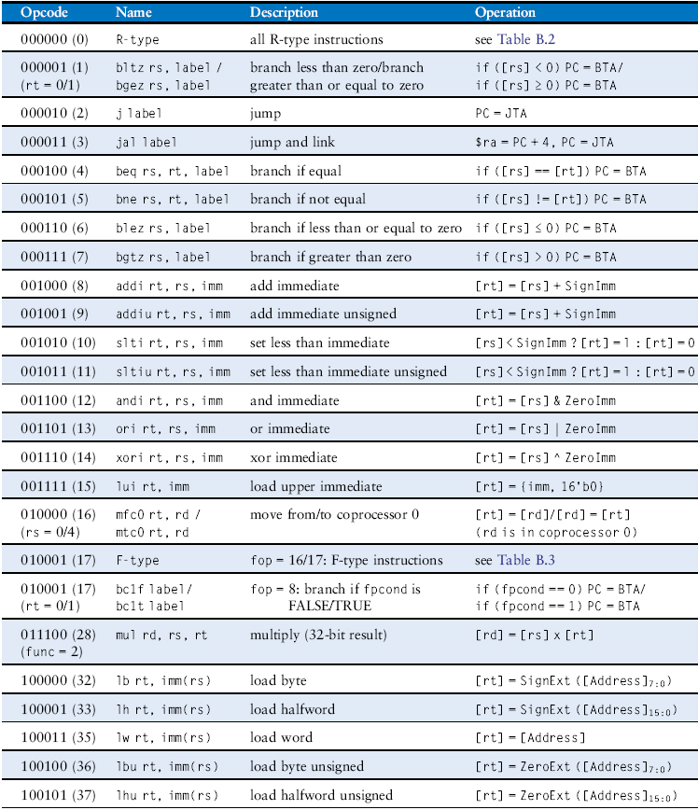
MIPS Instruction Set
Table B.1 Instructions, sorted by opcode
Copyright © 2013 Elsevier Inc. All rights reserved.

Slide 19
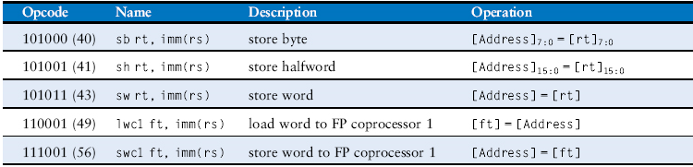
MIPS Instruction Set
Table B.1 Instructions, sorted by opcode
Copyright © 2013 Elsevier Inc. All rights reserved.

Slide 20
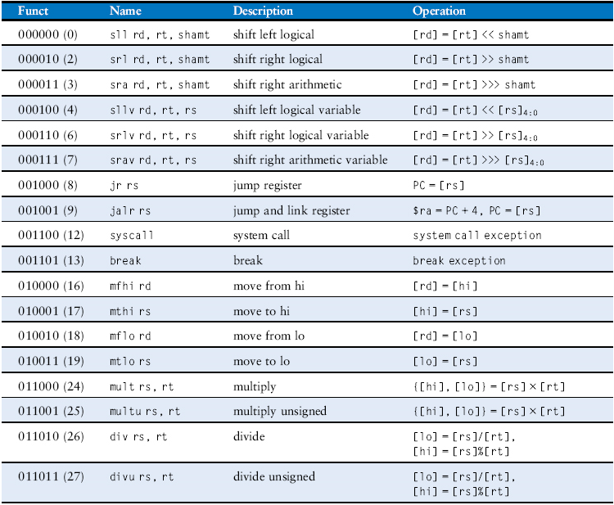
MIPS Instruction Set
Table B.2 R-type instructions, sorted by funct field
Copyright © 2013 Elsevier Inc. All rights reserved.

Slide 21
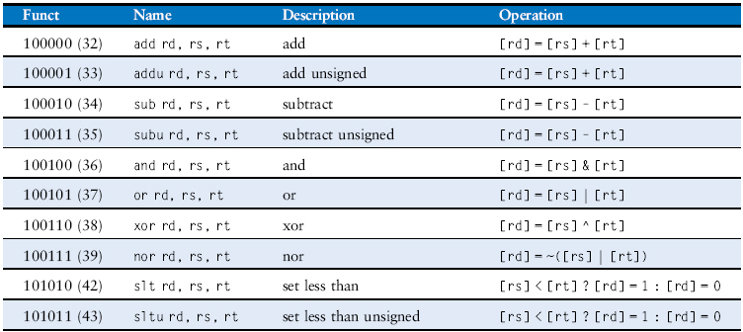
MIPS Instruction Set
Table B.2 R-type instructions, sorted by funct field
Copyright © 2013 Elsevier Inc. All rights reserved.

Slide 22
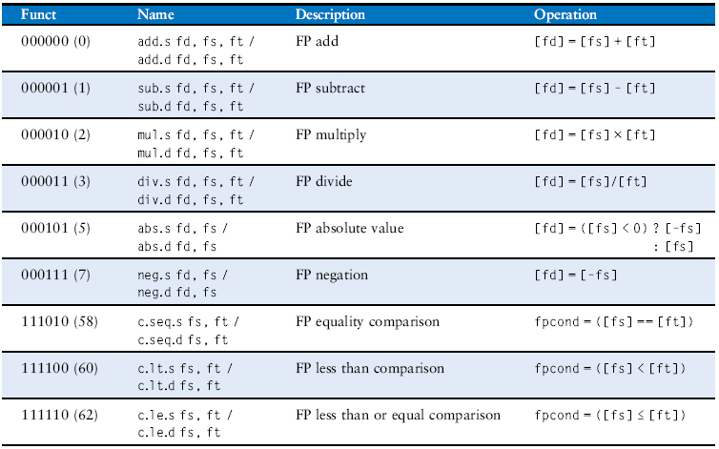
MIPS Instruction Set
Table B.3 F-type instructions (fop = 16/17)
Copyright © 2013 Elsevier Inc. All rights reserved.

Slide 23
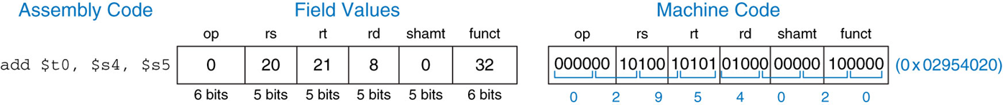
R-Type Instructions
R-Type Instructions – Register Type
Uses 3 registers operands (2 source, 1 destination)
Example Assembly Instruction: instr rd, rs, rt
Ex: add $t0, $s4, $s5
R-Type
op | rs | rt | rd | shamt | funct
6 bits | 5 bits | 5 bits | 5 bits | 5 bits | 6 bits
Destination
Source

Slide 24
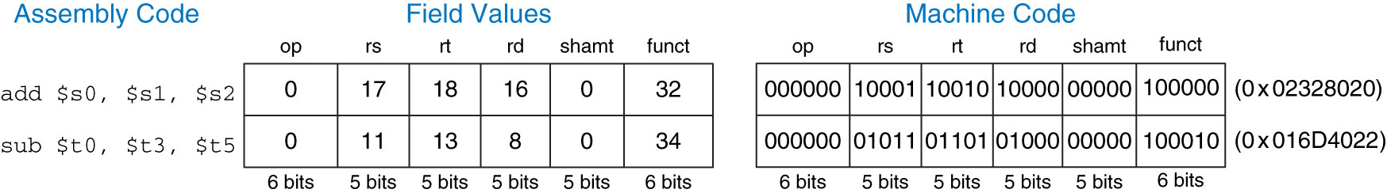
R-Type Instructions
You Try:
Ex: add $s0, $s1, $s2
Ex: sub $t0, $t3, $t5

Slide 25
I-Type Instructions
I-Type Instructions – Immediate Type
Uses 2 registers operands and 1 immediate operand
Example Assembly Instruction:
instr rt, rs, imm
instr rd, imm (rs)
Ex: addi $s3, $s3, 4
I-Type
op | rs | rt | imm
6 bits | 5 bits | 5 bits | 16 bits

Slide 26

26

Slide 27
Bit Masking
Given: A = 0x12345678
B = 0xFFFF0000
What is A AND B (AB)?
What is A OR B (A+B)?
AND – clear bits
OR – set bits

Slide 28
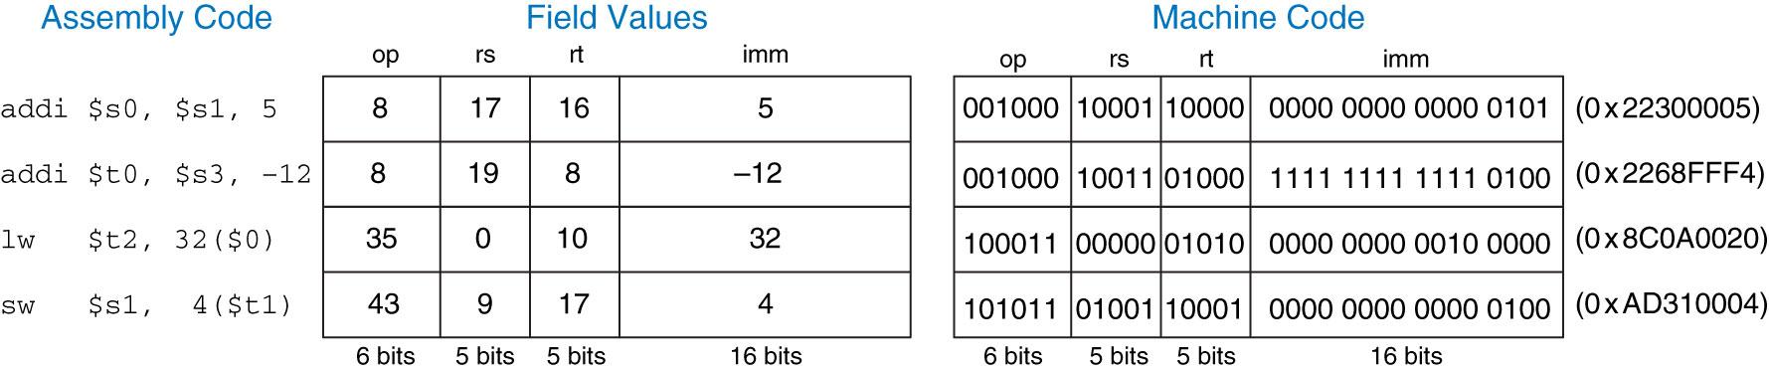
I-Type Instructions
Figure 6.9 Machine code for I-type instructions
Copyright © 2013 Elsevier Inc. All rights reserved.

Slide 29
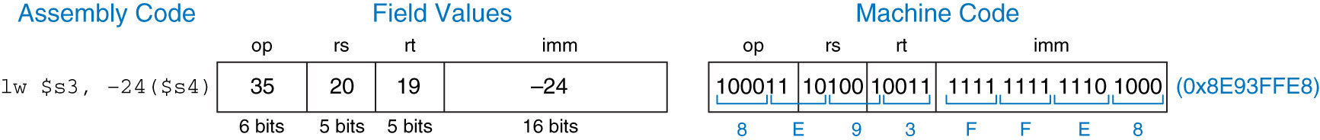
I-Type Instructions
Figure 6.10 Machine code for an l-type instruction
Copyright © 2013 Elsevier Inc. All rights reserved.

Slide 30
J-Type Instructions
J-Type Instructions – Jump Type
j or jal (jr is an R-Type Instruction that uses only the rs operand)
26 Bits for the Target or offset value → Pseudo-Direct Addressing
New address is computed by taking the upper 4 bits of the PC, concatenated to the 26 bit immediate value, and the lower two bits are 00, so the address created remains word-aligned. PC <- PC31-28 & IR25-0 & 00
J-Type
op | addr
6 bits | 26 bits
Copyright © 2013 Elsevier Inc. All rights reserved.

Slide 31
J-Type Instructions
Given this code convert Jump:
0x00400000 addi $s0, $0, 4 # $s0 = 4
0x00400004 addi $s1, $0, 1 # $s1 = 1
0x00400008 j target # jump to target
0x0040000c addi $s1, $s1, 1 # not executed
0x00400010 sub $s1, $s1, $s0 # not executed
target:
0x00400014 add $s1, $s1, $s0 # $s1 = 1 + 4 = 5
J-Type
op | addr
6 bits | 26 bits
Copyright © 2013 Elsevier Inc. All rights reserved.

Slide 32
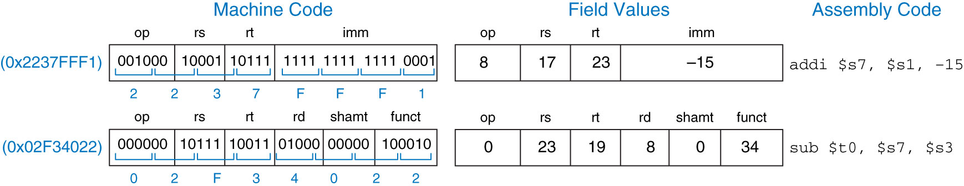
More Instructions
Figure 6.12 Machine code to assembly code translation
Copyright © 2013 Elsevier Inc. All rights reserved.

Slide 33
Machine Code to Assembly
Find the Assembly Function:
Given Machine Code: 0xAD310004

Slide 34
MIPS Register Set
Copyright © 2013 Elsevier Inc. All rights reserved.

Slide 35
MIPS Instruction Set
Table B.1 Instructions, sorted by opcode
Copyright © 2013 Elsevier Inc. All rights reserved.

Slide 36
MIPS Instruction Set
Table B.1 Instructions, sorted by opcode
Copyright © 2013 Elsevier Inc. All rights reserved.

Slide 37
MIPS Instruction Set
Table B.2 R-type instructions, sorted by funct field
Copyright © 2013 Elsevier Inc. All rights reserved.

Slide 38
MIPS Instruction Set
Table B.2 R-type instructions, sorted by funct field
Copyright © 2013 Elsevier Inc. All rights reserved.

Slide 39
MIPS Instruction Set
Table B.3 F-type instructions (fop = 16/17)
Copyright © 2013 Elsevier Inc. All rights reserved.

Slide 40
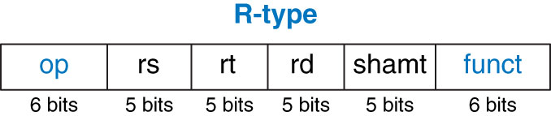
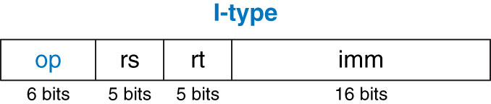
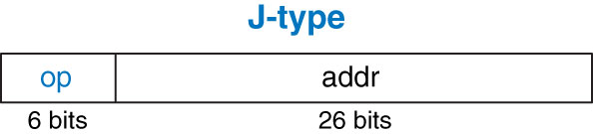
MIPS Instruction Types
Register
Figure 6.5 R-type machine instruction format
Immediate
Figure 6.8 I-type instruction format
Jump
Figure 6.11 J-type instruction format
Copyright © 2013 Elsevier Inc. All rights reserved.

Slide 41
MIPS Register Set
Copyright © 2013 Elsevier Inc. All rights reserved.

Slide 42
MIPS Register Set
Copyright © 2013 Elsevier Inc. All rights reserved.

Slide 43

R-Type Instructions
Figure 6.7 Machine code for the R-type instruction of Example 6.3
Copyright © 2013 Elsevier Inc. All rights reserved.

